Slide 1
Musical Instrument Classification Using a Hybrid Neural Network
Landon Buell, Kevin Short
University of New Hampshire
8 Jan 2020

Slide 2
Introduction

Slide 3
Mapping Sounds to Sources
Humans are proficient at mapping sounds to sources
Impractical at a large scale
Computers are not proficient at mapping sounds to sources
Can handle large volumes of data

Slide 4
“Birds inspired us to fly, burdock plants inspired Velcro and nature has inspired many other inventions. It seems only logical then, to look to the brain’s architecture for inspiration on how to build an intelligent machine.”
- Aurelion Geron, Former YouTube Video Classification lead

Slide 5
The Nerual Network

Slide 6
Structure
A neural network is a mathematical function
Composed of smaller functions called layers
Transform features into predictions

Slide 7
Classification Model
Inputs are mapped to qualitative outputs (musical instruments)
We group inputs that have similar properties
This is called a classification neural network

Slide 8
Existing Models
Inputs is 2D image-like array
Transformed through Convolution and Pooling Layers
Convolution Network

Slide 9
Existing Models
Input is 1D array of features
Transformed through Dense Layers
Multilayer Perceptron

Slide 10
Hybrid Network Architecture

Slide 11
Two Modes of Input
Each model uses a different input Modes
2D Spectrogram vs. 1D Feature Vector
Compare Modes to human senses

Slide 12
Multimodal Network
Model built with two input modes
CNN branch accepts a 2D spectrogram images
MLP branch accepts a 1D vector of features

Slide 13
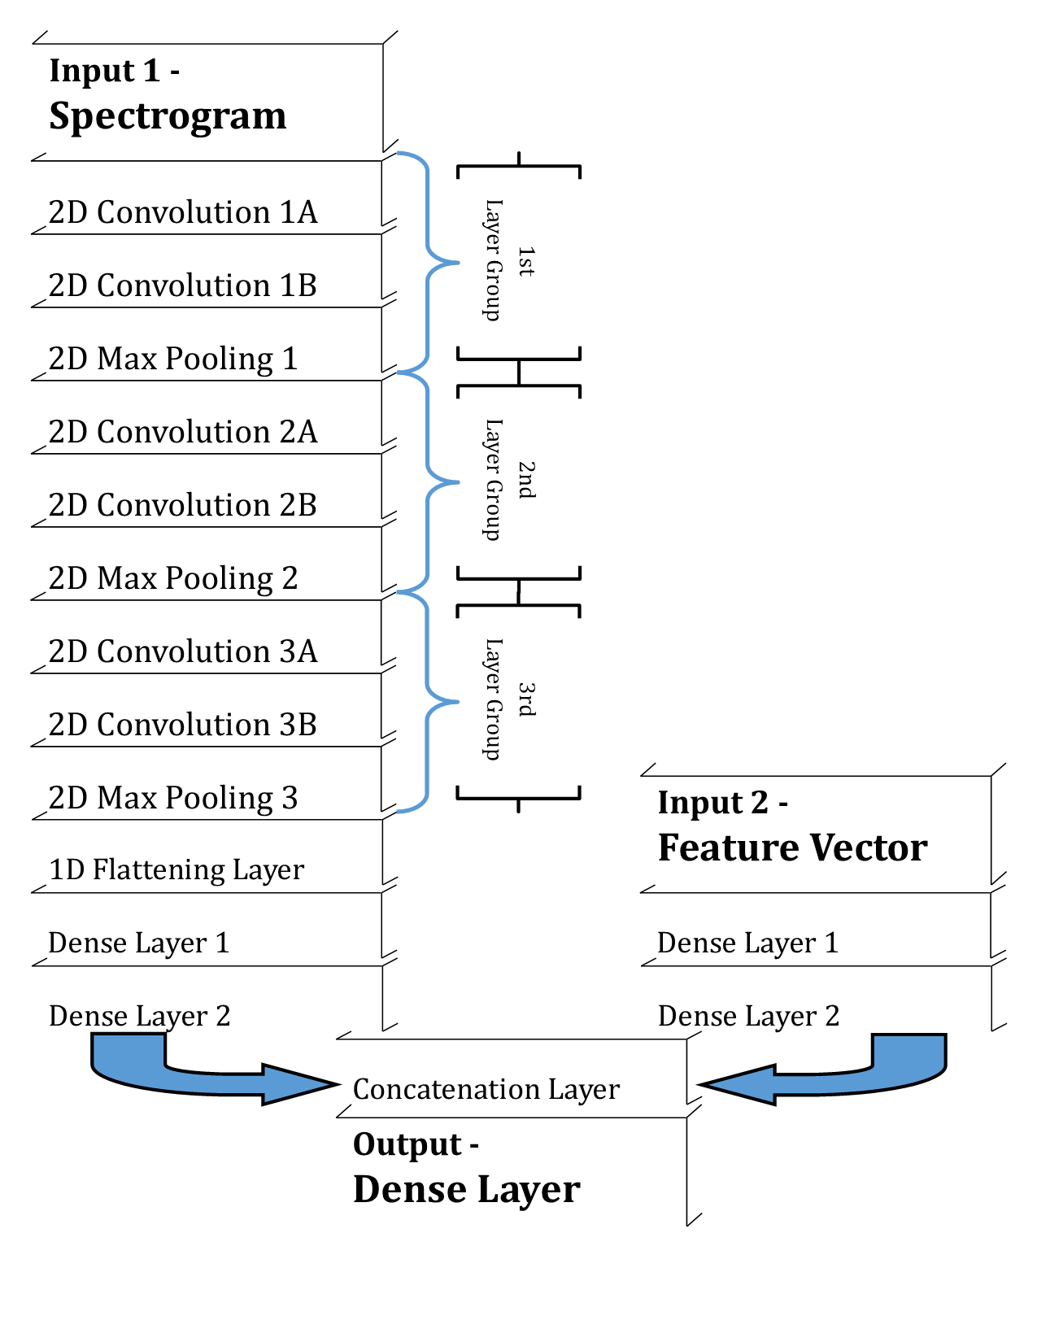
Hybrid Neural Network Architectures

Slide 14
Performance of the Hybrid Model

Slide 15
Confusion Matrices

